Slide 1
MycroForest - Exploring the use of a microworld to teach about economic viability of climate aware forest management.
Gayathri Girish Nair Course: MSc. Computer Science

Slide 2
Background
AREA OF INTEREST
Carbon emissions & climate change.
Role of forests as carbon sinks.
Teaching about challenges associated with staying climate aware while ensuring economic viability.
Notes:
Climate change, the role of forests as carbon sinks, and spreading awareness about challenges around combating climate change while maintaining economic viability comprise the premise of this project.

Slide 3
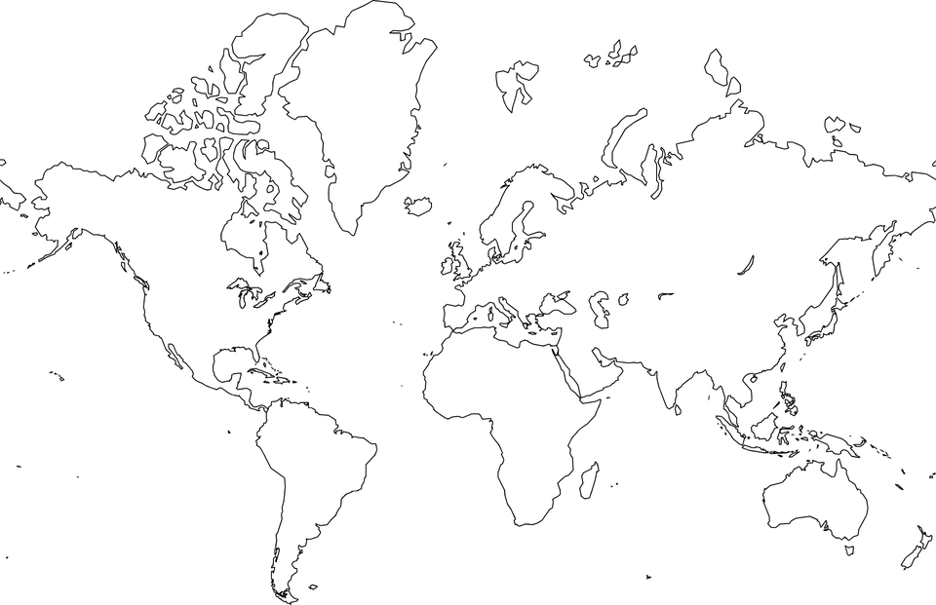
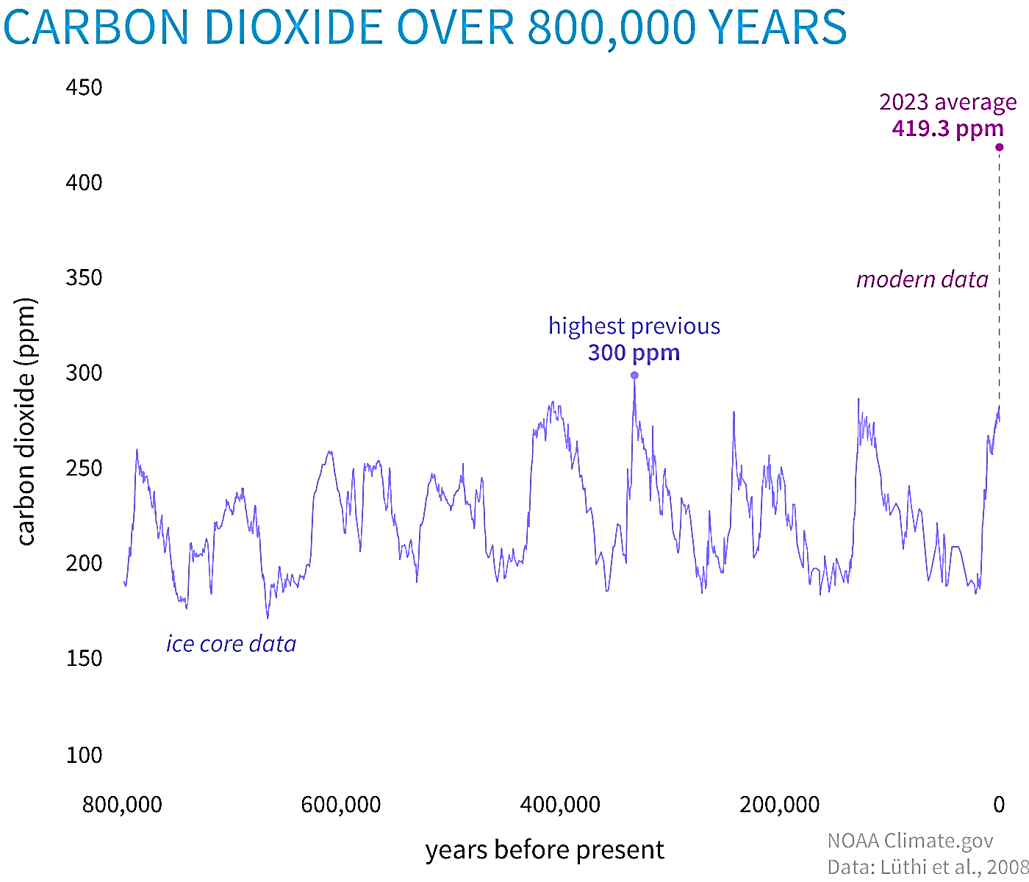



Background
USA 43°C (2024) [1]
https://www.climate.gov/media/15993
CO2: Important Greenhouse Gas
CLIMATE CHANGE
Extreme Climate: Heatwaves, Floods, Wildfires, Storms …
Disruption of Industry: Agriculture, Energy, Infrastructure …
Health Risks
NEED TO EDUCATE & INSPIRE RIGHT ACTION
MEXICO 51.9°C (2024) [2]
CO2 Conc. In Air = ↑ rapidly
EUROPE (2023) was the hottest year on record [3]
INDIA 50 °C (2024) [4]
Human Evolution
CO2 = 200 – 300 ppm
Now (22 June 2024)
CO2 = 427 ppm
Forests absorb 30% of global
emissions per year [6] but are fragile.
UN SDG GOAL 4
High demand for wood [7].
Pre-Industrial
CO2 = 280 ppm
Dangerous
CO2 = 430 ppm [5]
FORESTS
Notes:
This has been a year of unprecedented heat in many parts of the world. In addition to extreme weather and a negative impact on health of most living things, rapid climate change and global warming also disrupt our key industries.
As many of us are aware, carbon dioxide levels in the atmosphere is a key driver of global warming. CO2 is an important greenhouse gas. It helps keep the planet warm enough to make life possible. But in a very short time since the industrial revolution, human activities have released a very large amount of carbon into the air, and this has led to current atmospheric CO2 concentration being higher than ever before in over 800,000 years. In 2023, the concentration was 419.3 parts per million (ppm). On 22 June 2024, this was 427 ppm. It was predicted that if CO2 levels rose to 430 ppm, then we would experience widespread dangerous weather conditions and this year seems to reenforce this.
So, there is an urgent need for action against climate change. Forests are crucial to fighting climate change because they currently absorb around 30% of global emissions. But they are fragile. If enough of a forest is cleared, they begin to release more carbon than they absorb. Given our high demand for wood, this is already beginning to happen.
Thus, once again, spreading awareness about the importance of forests as carbon sinks is crucial to ensuring a sustainable future and is therefore in alliance with goal 4 "Quality Education" of the SDG set by the UN.

Slide 4
Related Work
EXISTING TOOLS
Either scientifically accurate decision-making aids or more abstract yet informative educational games, often with a collaboration element and some reference to climate change.
Most cater towards adults with few focussing on younger audiences.
Most tackle multiple problems at once such as land use changes as well as forest management along with resource management, which while informative, may be distracting and/or overwhelming, especially for young learners.
To the best of knowledge yet, none that explicitly associates forest management and CO2 levels in the atmosphere and thus global warming while also considering economic viability of the forest.

Slide 5
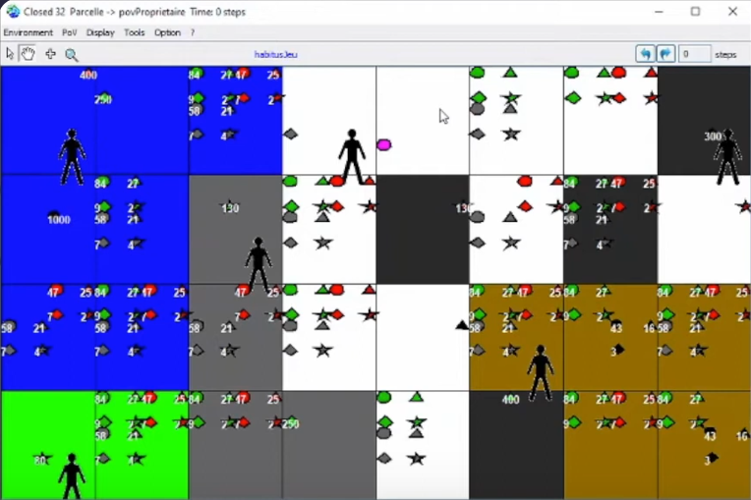
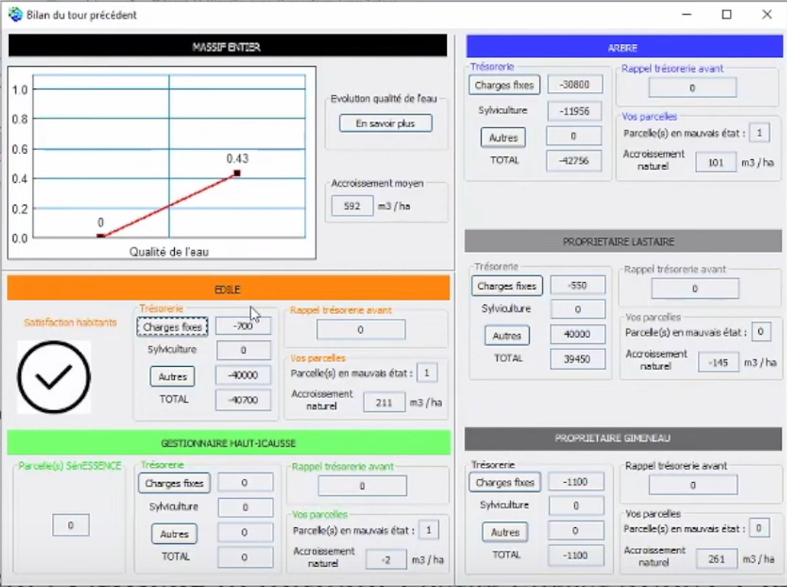
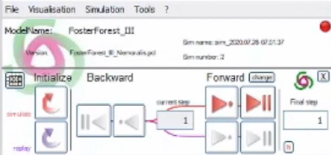
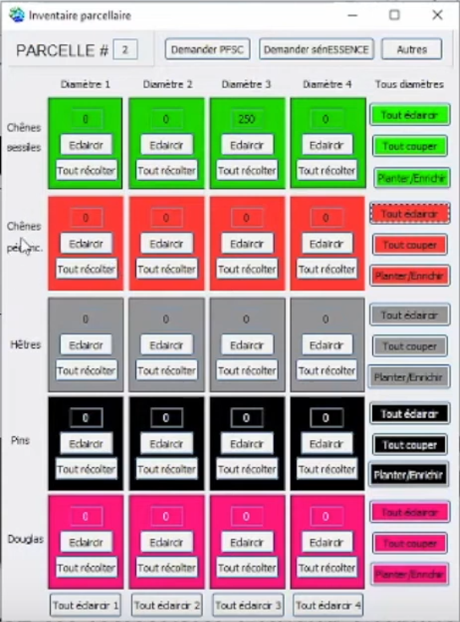
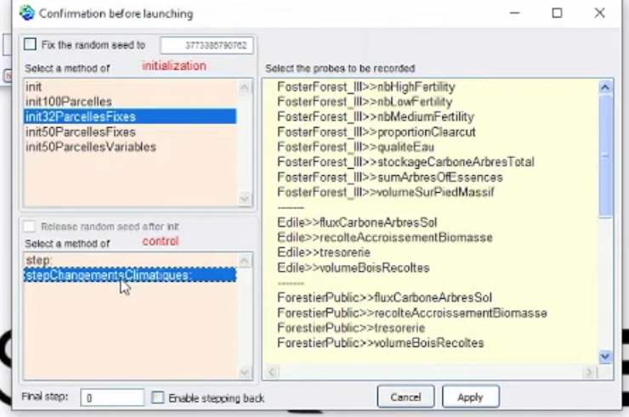
Related Work
FOSTER FOREST – Decision Making Aid
A 5 expert players + 1 facilitator, role-playing game that simulates forestry under changing climatic conditions.
PROS: ComMod, very engaging, realistic ecosystem model, rich variety of important scenarios (water quality upkeep, land use results, carbon sequestration, species conservation, etc.).
CONS: Very high learning curve (2 usage videos, 6 booklets). Very difficult to use with young or non-expert audiences. Need for elaborate set up (2 projectors + 1 expert facilitator), an expert facilitator, UI is not very user friendly, lacks feedback upon climate changes.
[8]

Slide 6
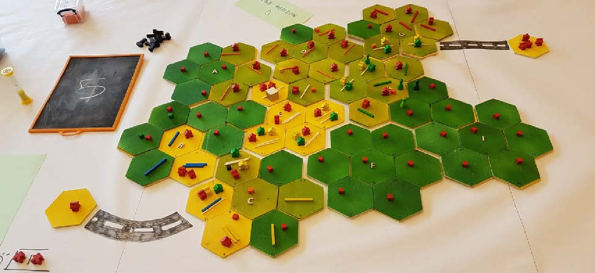
Related Work
In 2023, P. O. Waeber et. al. tried this game with Forestry graduate students online via a zoom call. THEY confirm good engagement, a great learning experience, and emergence of realistic strategies. There is a need for a fully digital version of this and/or similar games for use as widely accessible, effective, transformative learning tools. [10]
MINE SET – Educational Game
A role-playing board game where players act as CEOs of logging or mining companies and interact with markets, the government, and NGOs to develop strategies which alter land use as measured in terms of forest cover, biodiversity, and volumes traded. The underlying model captures all main drivers of land use change in central African forests (demographics, economical, governance, technological, cultural) via simple rules. [9]
PROS: ComMod, engaging, captures rich variety of land use change drivers, model progression, immersive.
CONS: Allegorical model, (not scientifically accurate), significant set up needed.

Slide 7
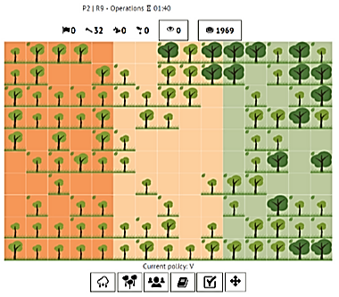
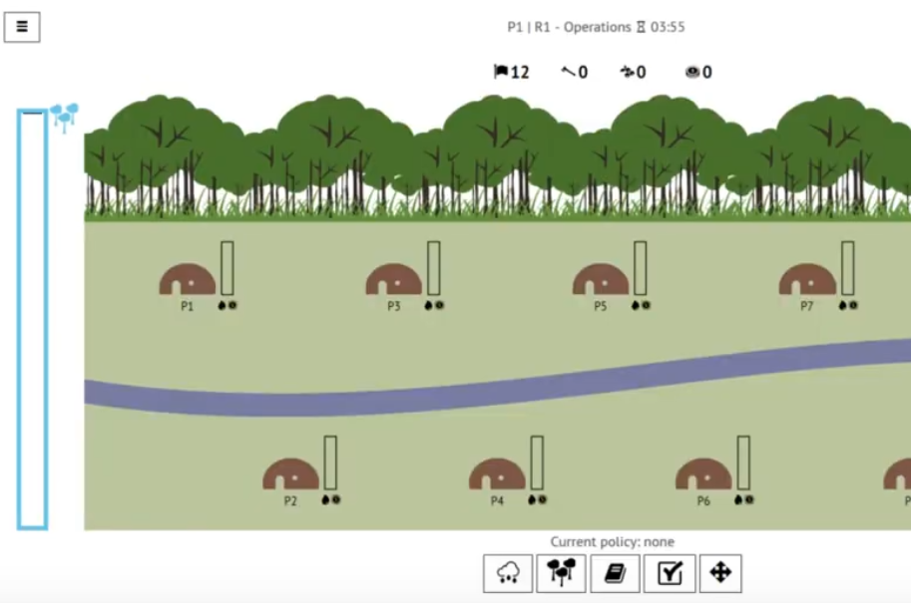
Related Work
ABOUT THAT FOREST – Educational Game
Web Based multi-player RPG where learners play as forest dwellers who draft and vote on policies to decide on harvesting trees or selling non-timber forest products to make money. Players can also plant new trees and monitor others. The environment reciprocates poor health of the forest via floods that lead to loss for all community members.
PROS: ComMod, engaging, competition v/s cooperation, Explores Economic Driver of Exploitation, widely accessible, appeals to a wider age group and range of starting knowledge level.
https://games4sustainability.org/gamepedia/about-that-forest/

Slide 8
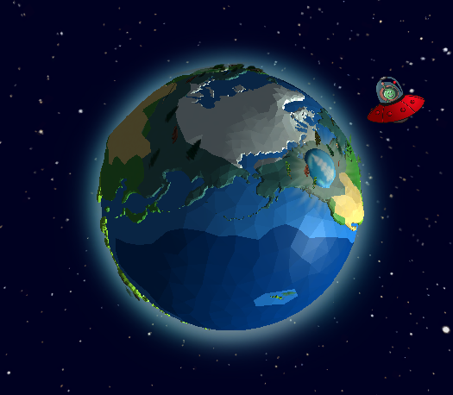
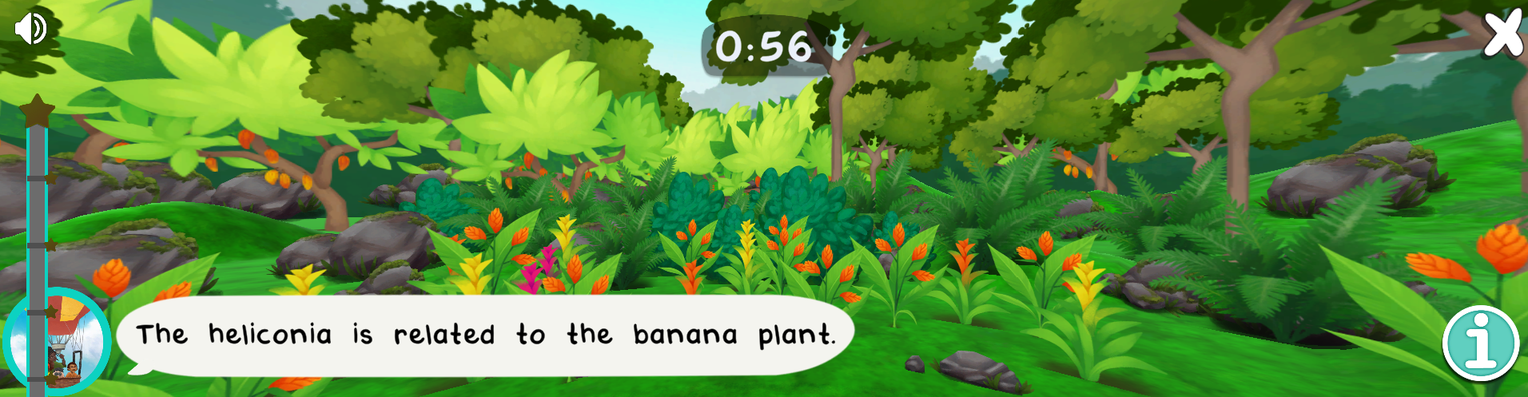
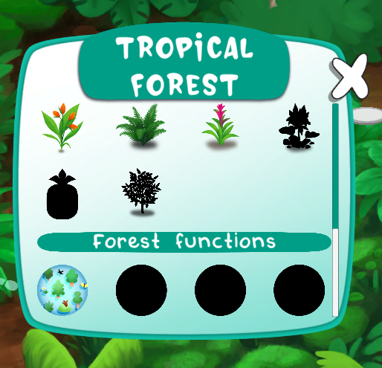
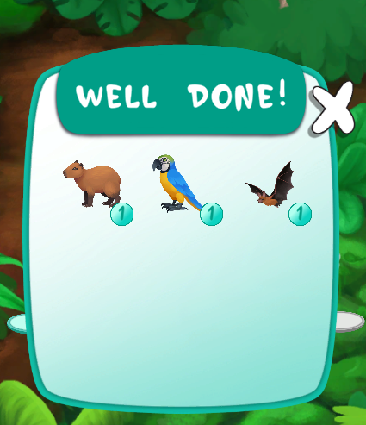
Related Work
FOREST KIDS – Educational Game
Web based game for children where they visit different types of forests and can discover various flora and fauna along with services that the forest offers. Contains fun mini games like picture matching and biodiversity spotting. Provides short fun facts. Learners earn points and can collect spotted species.
https://www.esa.int/Education/Forest_Kids_game_on_biodiversity_now_available
PROS: Very engaging, rich variety of activities, very user friendly, suitable for young children, lots of in-app help in small amounts, visually attractive.

Slide 9
Related Work
X
Not multiplayer but allows for team learning activities.
PRESENTED APP
EXISTING TOOLS
INFORMATIVE TOOL → QUALITY ↓ | FOSTER FOREST | MINE SET | ABOUT THAT FOREST | FOREST KIDS | MYCROFOREST
ENGAGING | ✔ | ✔ | ✔ | ✔ | ✔
FOR YOUTH | ✘ | ✔ | ✔ | ✘ | ✔
EASILY ACCESSIBLE | ✘ | ✘ | ✔ | ✔ | ✔
TEAM | ✔ | ✔ | ✔ | ✔ | ✘
SOLO | ✘ | ✘ | ✘ | ✔ | ✔
FOREST MANAGEMENT | ✔ | ✔ | ✔ | ✘ | ✔
FOREST AS CARBON SINK | ✔ | ✘ | ✘ | ✘ | ✔
FINANCIAL MOTIVE | ✔ | ✔ | ✔ | ✘ | ✔
LOW ENTRY THRESHOLD | ✘ | ✘ | ✔ | ✔ | ✔
EASY TO USE UI | ✘ | ✔ | ✔ | ✔ | ✔
SCIENTIFICALLY ACCURATE | ✔ | ✘ | ✘ | ✔ | ✘
SUFFICIENT BUILT IN HELP | ✘ | ✘ | ✔ | ✔ | ✔
SINGLE TARGET | ✘ | ✘ | ✔ | ✔ | ✔
✘
✘
Allegorical representation of carbon cycle and
real-world plant growth behaviour. Focus is on why. Not how.
X
Notes:
Mycroforest is the application that this project presents. There are multiple existing similar tools as listed along the top of the table here. Along the side of the table, are qualities that these other tools and Mycroforest is scored against. Many apps are very scientifically accurate decision-making tools like foster forest aimed at experts or adults. Mycroforest is not like this because the underlying conceptual model for teaching about forest management, need not capture plant growth and the carbon cycle in extreme detail. It is a simple, yet reflective model of the real world as is the case with others like mine set and about that forest. Mycroforest meets all intended criteria w.r.t this project. It is an engaging, easily accessible web-based application aimed at the youth. Although the app itself is not multiplayer, it allows for team learning activities in addition to individual ones. Unlike many existing tools that try to do multiple things at once, Mycroforest focuses exclusively on forest management, it's effect on atmospheric CO2 levels and the impact of financial motives. This app is built to be easy to get into and use with lots of built-in help. There is a slide for each of the 4 other apps which we can take a look at after this presentation, if you’d like that.

Slide 10
MycroForest - Educational Approach
Microworld → Good Engagement, Constructivist Thinking
Targets, Challenges → Structure, Problem Based Learning
Competition Among Teams → Gamification, Motivation
Debriefing → Reflective Learning, Inquiry Based Learning
Facilitator → Structure, Guidance, Inquiry Based Learning
Graphical Feedback + Short Explanations → High Effectiveness
Model Progression → Lowers Entry Threshold
[12] [13] [14] [15]

Slide 11
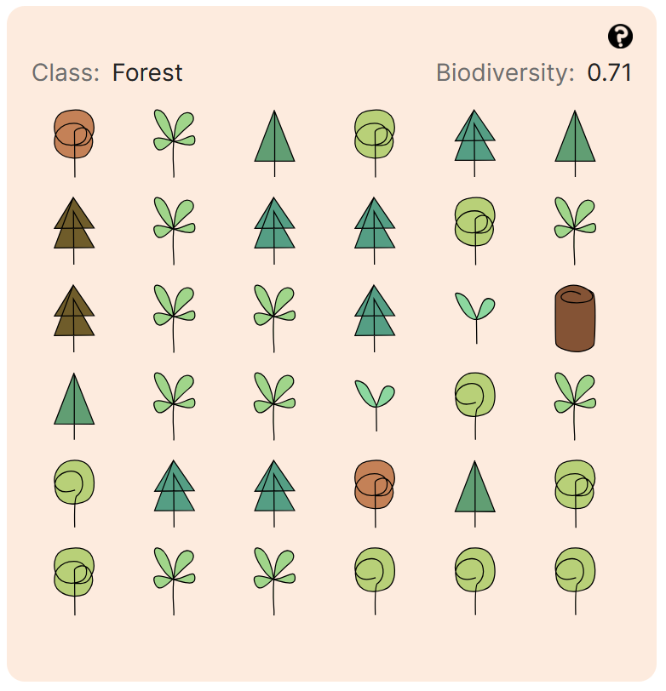


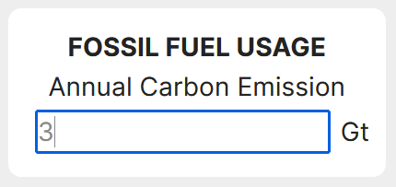
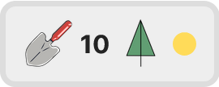
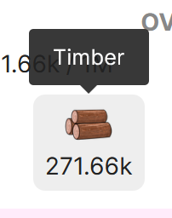
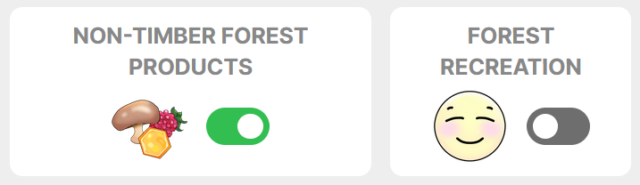

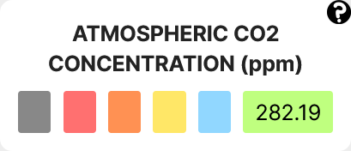
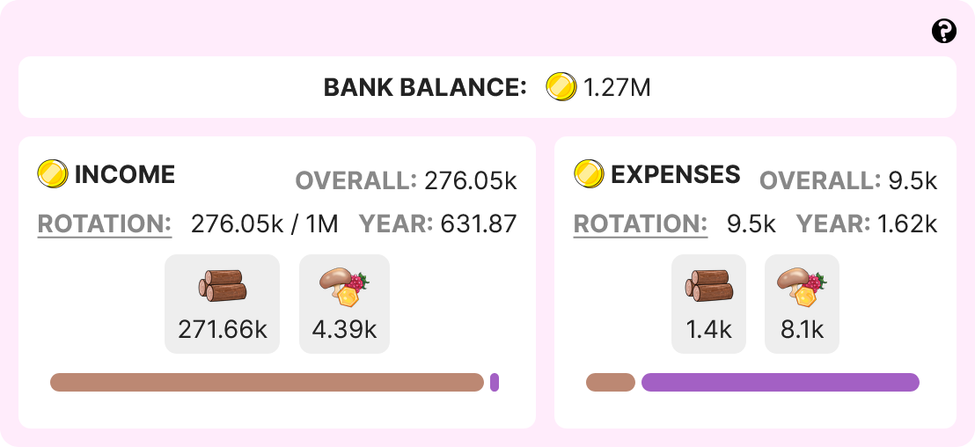
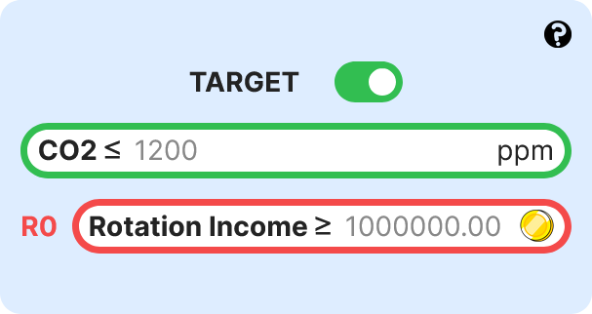
MycroForest Approach
FUNCTIONAL REQUIREMENTS
Move across time to see the plan in action.
Introduce emissions due to fossil fuel usage.
Plan frequency and timing of planting/felling trees.
Earn coins from selling wood/non-timber forest products and/or by opening the forest to public recreational use.
Get your personal forest with 2 types of trees at different stages in their life.
View atmospheric CO2 levels.
Set CO2 and income targets.
View income and expenses.

Slide 12
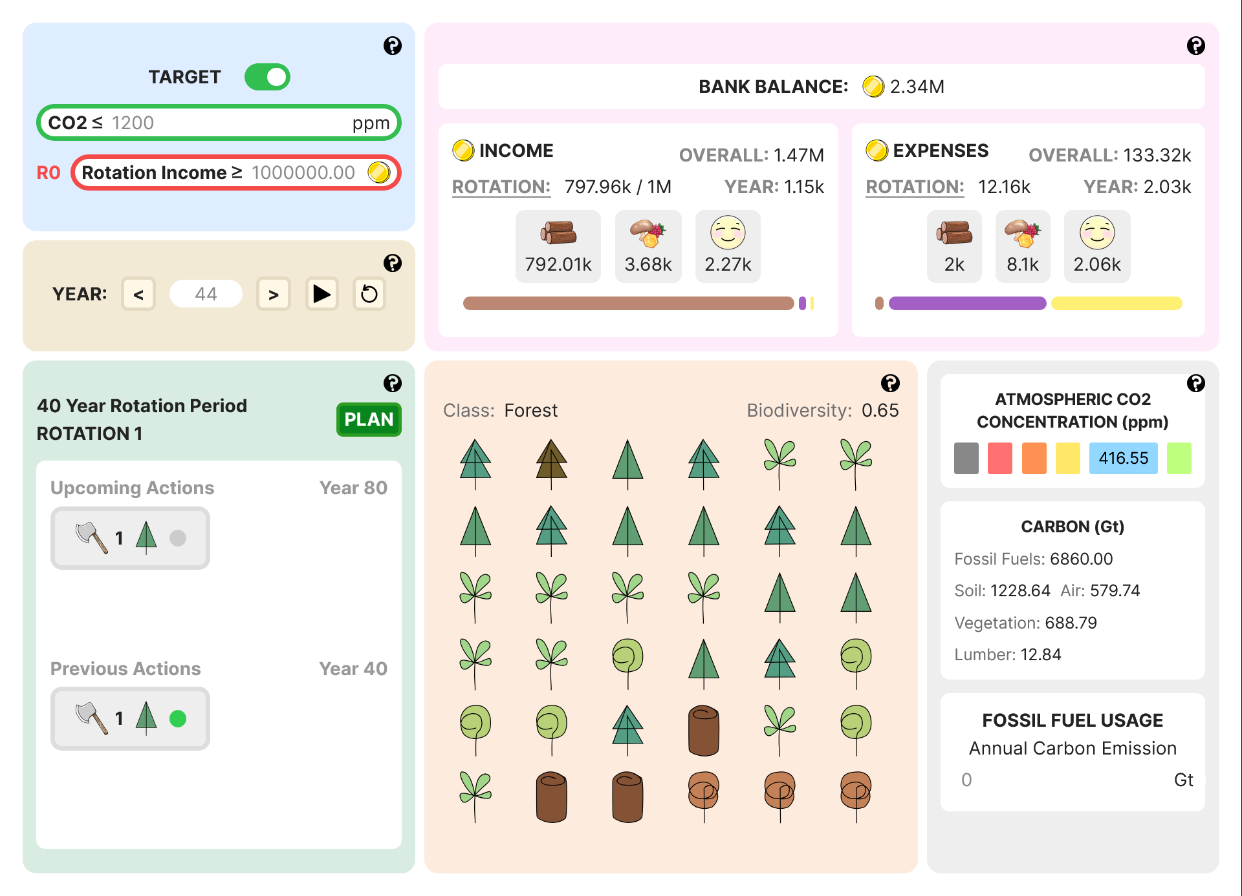
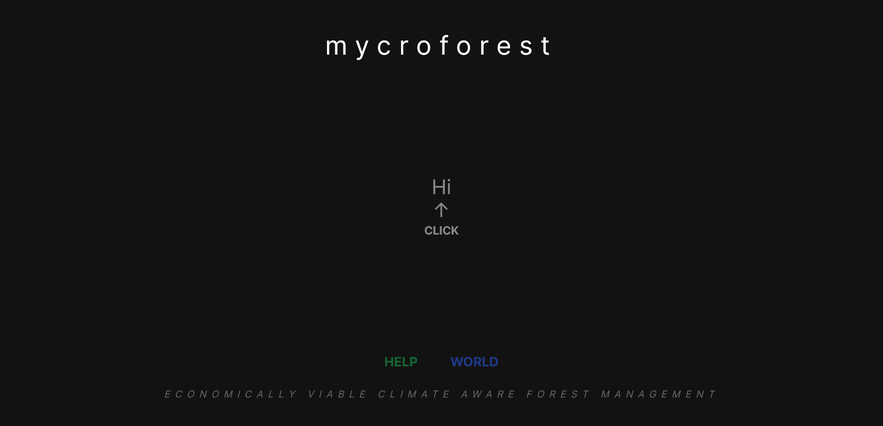
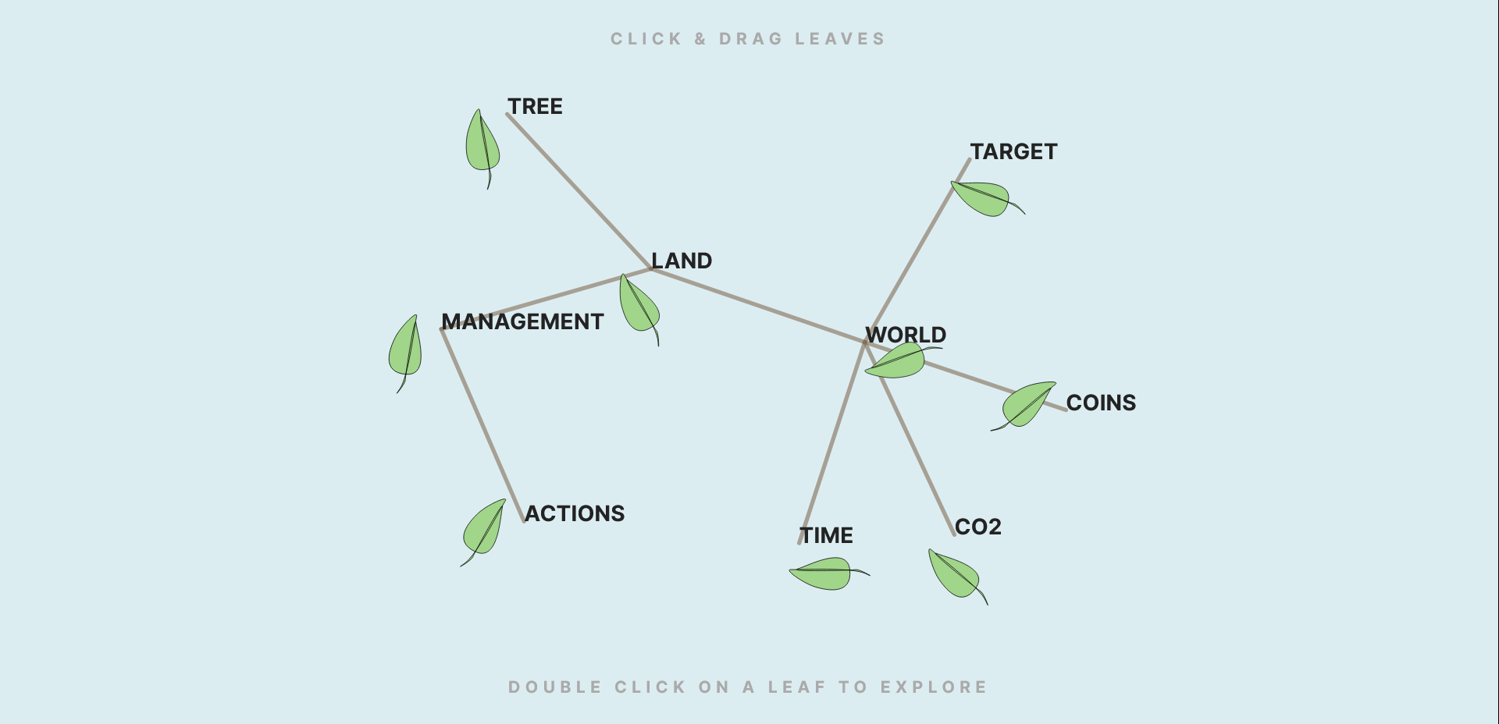
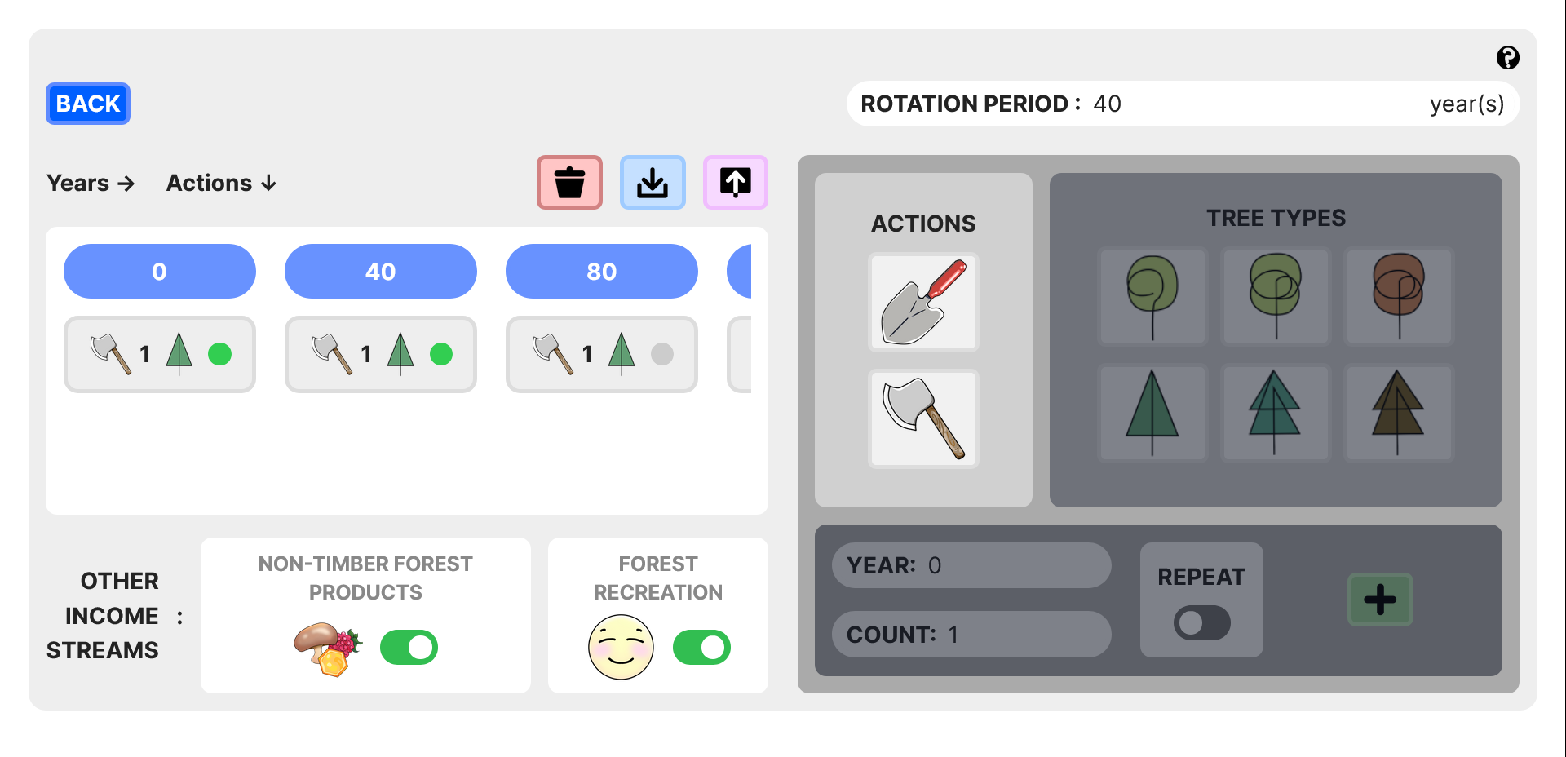
Design
CURRENT APP
UI COMPONENTS
LANDING HELP HOME PLANNER
HOME
HOME
HOME
APP PAGES
SIMULATION MODEL
INPUT VARIABLES
UTILS

Slide 13
Design
SOME CHANGES OVER TIME

Slide 14
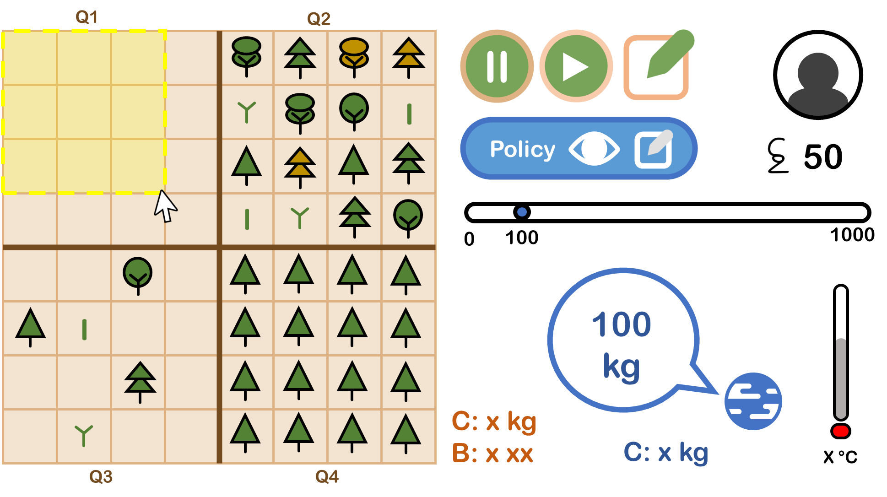
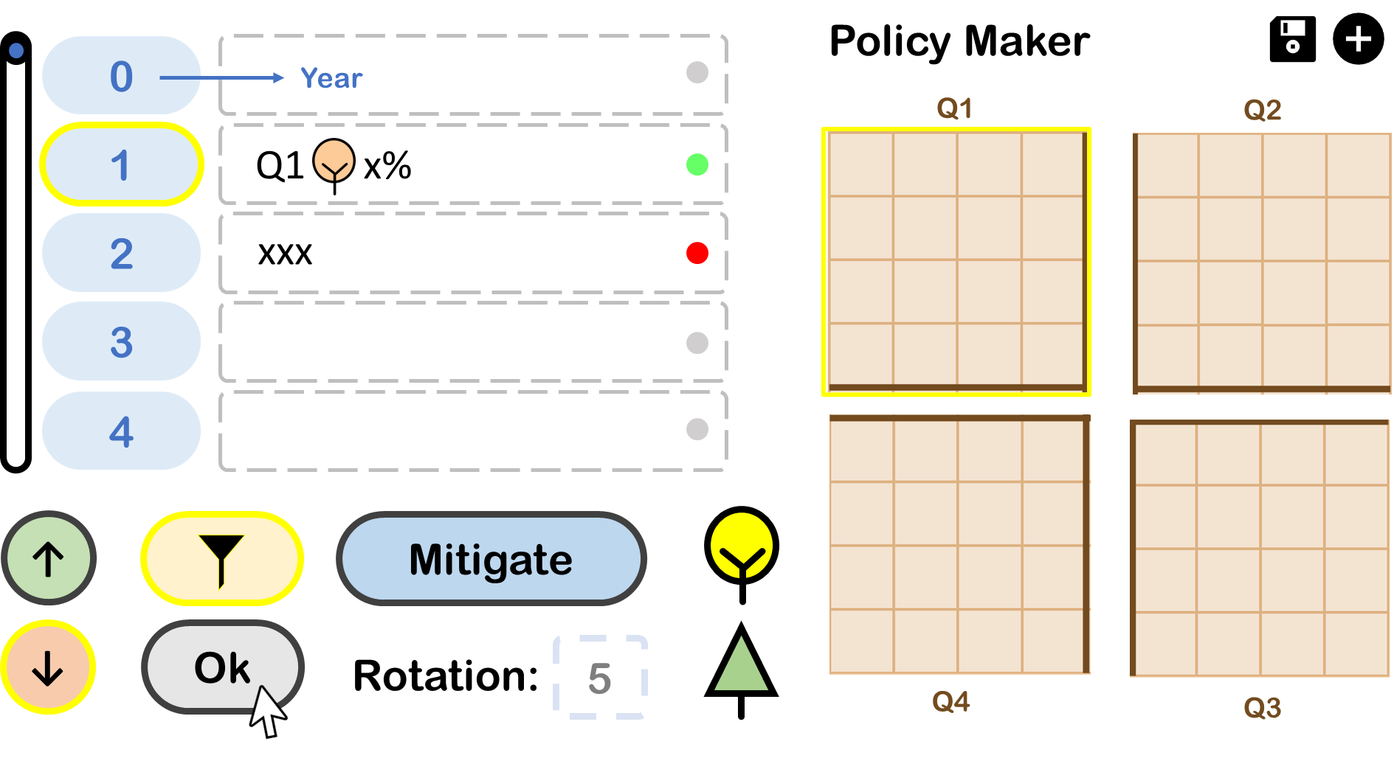
Design
MOCKUP 1
(MS Power Point)

Slide 15
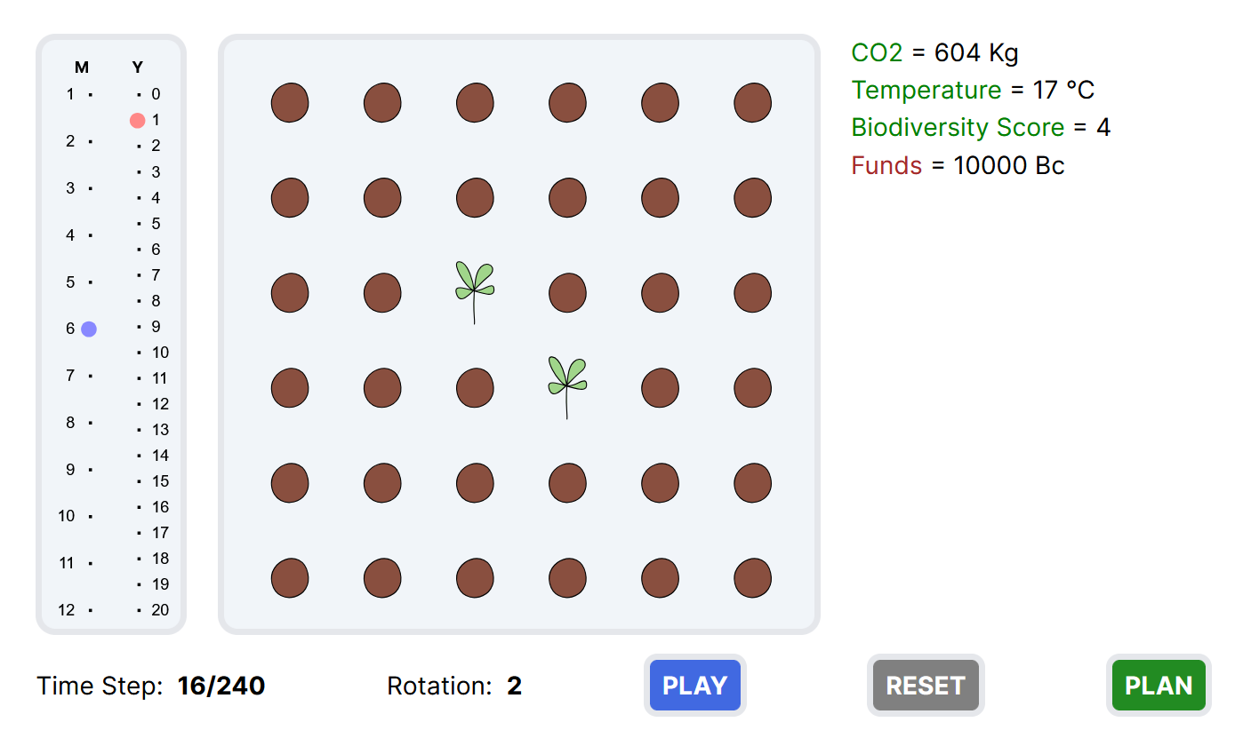
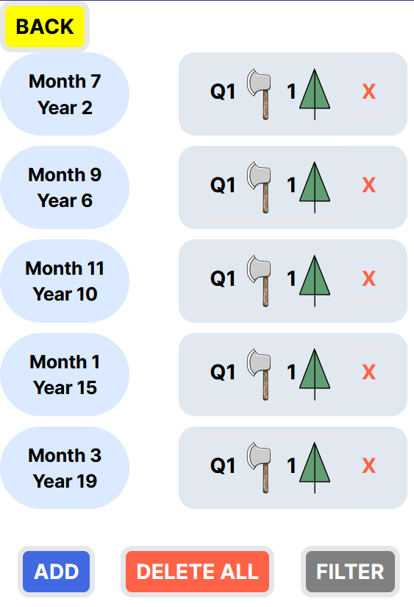
Design
PROTOTYPE 1 (Web)

Slide 16

Design
https://www.figma.com/proto/Wmpkm80wpOe5lTfVKL0B9V/Mockup?node-id=0-1&t=R0TNsFjvVC2MEEUk-1
MOCKUP 2 (Figma)

Slide 17
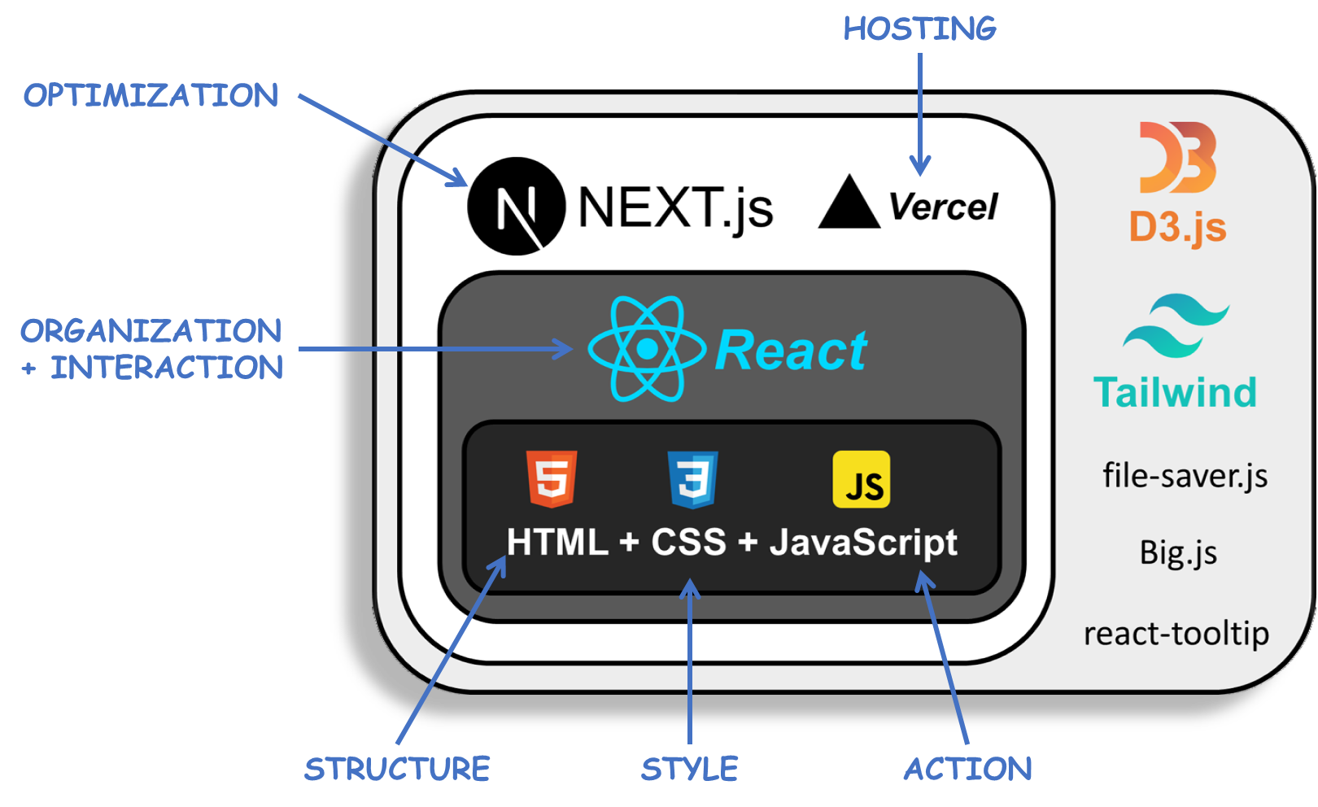
Design
TECHNICAL ARCHITECTURE

Slide 18
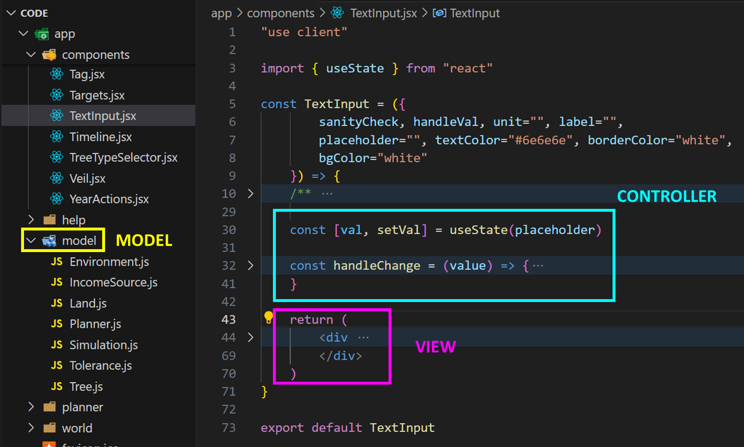
Design
AVOIDING COMMON PITFALLS
BAD DESIGN ELEMENT |  | COUNTER MEASURES TAKEN
RIGIDITY | Difficult to change. | Separation of concerns by sticking to the Model View Controller design pattern. Underlying model is separate from React components and is organized into classes in an Object Oriented Fashion.
FRAGILITY | Prone to breaking. | Modular testing (app and specific components tested immediately after implementation of each new feature). GitHub for version control. Lessen rigidity.
IMMOBILITY | Difficult to reuse. | Choice to use ReactJS allows for creation of reusable components. Example: <Button/>, <Switch/>, <Card/>, <Veil/>, etc.
VISCOSITY | Hacks over the right thing. | Temporary fixes were avoided or immediately replaced as soon as correct solution was identified. Example: Decision to change structure of code early on and start afresh instead of continuing work on initial prototype code.
Model View Controller

Slide 19
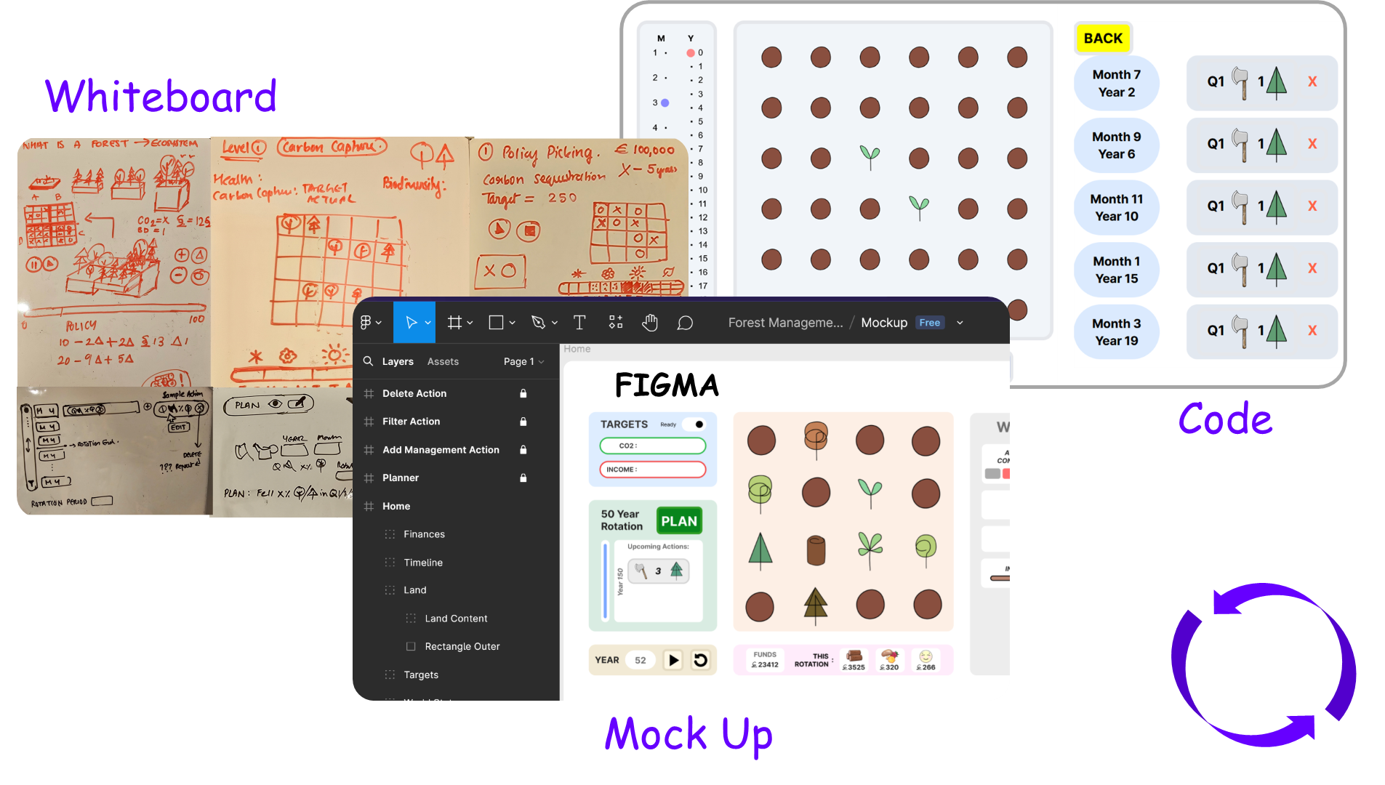
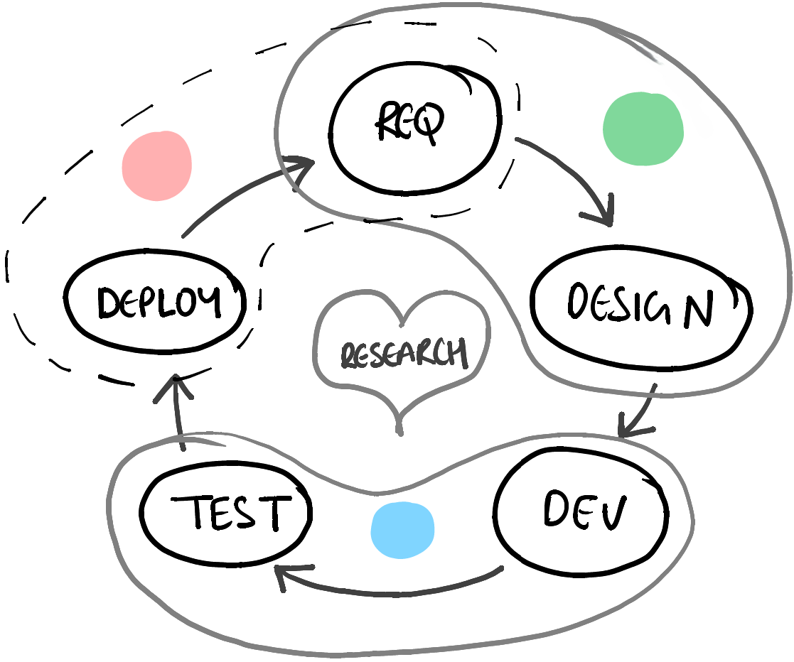
Design
STAYING AGILE
Deployment
& Analysis
Planning
Iterative Development
Frequent Feature Delivery,
Feedback and Improvement
Building
CICD Pipeline Set Up using &
GitHub
Vercel

Slide 20
Design
SOME PROJECT-SPECIFIC CHALLENGES
PROBLEM: Precision issues when working with astronomically large numbers.
SOLUTION: Big.js library.
PROBLEM: Integrating D3.js v7 with NextJS technologies.
SOLUTION: Research + documentation + trial an error.
PROBLEM: Rigidity of software. Difficult to change.
SOLUTION: Move key variables to a separate environment file. Enforce Model View Controller design pattern.
PROBLEM: Getting the carbon cycle to keep CO2 concentration levels in balance.
SOLUTION: Consult co-supervisor. Research to arrive at real world numbers and maintaining ratios.
PROBLEM: Global values must be influenced by absorption and release from only 36 trees.
SOLUTION: Scale carbon absorbed and released by a fixed factor. Find right value through trial and error.
PROBLEM: Difficult to keep track of all model rules and design choices.
SOLUTION: Organize documentation corresponding to each interconnected component in graph format. I used Obsidian to do this.

Slide 21
Demo
https://microworld-dissertation-tcd.vercel.app/

Slide 22
Evaluation Plan (i)
Questionnaire: The form that the students filled in, comprised 16 UIUX related questions as defined in the widely used product satisfaction questionnaire, the PSSUQ. These are Likert scale questions with 1 (min) being strongly agree and 7 (max) being strongly disagree.
Additionally, 10 custom questions (6 Likert scale questions and 4 open-ended questions) regarding educational experience and attitude towards climate change was added to the questionnaire.
Please find this questionnaire here.
Triangulation: Feedback from tutors at the event and a domain expert in Botany (co-supervisor) shall also be collected.
The Mycroforest teaching tool was used for a 2 hrs session as part of a two-day workshop on Climate Change and Sustainability with (n=10) TY students on the TAP Bridge2College Programme.
Learning Activity:
Introduction (explanation by tutors and a short video).
Challenge 1 – Each team of students try to earn as much as they can from timber without worrying about CO2 emissions.
Discussion.
Challenge 2 – Each team of students try to keep atmospheric CO2 levels as low as they can and compare their new plan with the one from the previous challenge.
Discussion.
.
Questionnaire

Slide 23
Evaluation Results
LARGELY POSITIVE
BRIDGE TO COLLEGE LEARNING SESSION
Please find a summary of student feedback here.
Satisfaction: Overall positive response.
UIUX: Positive overall. 3 students suggest that the system throw more error messages. “Simplicity” and “Ease of use” were among most popular best aspects of the app as per student comments while suggestions for improvement included more help and error messages along with expansion of scenarios.
Learning & Value: All students agree that such apps make learning more engaging. All but 1 student agree that they found the experience and app valuable. “Very Informative” was among student comments.
Attitude Towards Climate Change & Forest: Interestingly, while most students were just as (5/10) or more (3/10) concerned about climate change after the use of the app as they were before. Concern level for 2 students dropped after use of the app. The reason may be increased confidence in use of forests as a carbon sink, but this is interesting and warrants further investigation.

Slide 24
What did I learn?
URGENCY OF NEED FOR ACTION AGAINST RAPID CLIMATE CHANGE
FORESTY PRACTICES, INCOME STREAMS, AND ROLE OF FORESTS AS CARBON SINKS
FEATURES OF EFFECTIVE EDUCATIONAL TOOLS
JOY OF SHARING KNOWLEDGE
OBJECT ORIENTED PROGRAMMING IN JAVASCRIPT
IMPORTANCE OF DOCUMENTATION & SOFTWARE DEVELOPMENT BEST PRACTICES
ADVANTAGE OF AGILE DEVELOPMENT METHODOLOGY
APP EVALUATION
ANOTHER CHANCE TO APPLY CONCEPTS FROM THE ADVANCED SOFTWARE ENGINEERING MODULE

Slide 25
Thank You

Slide 26
Conclusion
ACHIEVEMENTS & LIMITATIONS
ACHIEVEMENTS | LIMITATIONS
# A functional teaching tool that students found informative, fun, and simple to use. # Applied S/W development theory. # Experienced product evaluation process. # Learned about effective teaching/learning methods. # Learned about forests and their importance in the fight against rapid climate change. # Better appreciation for complexity of the natural world. # Furthered skill in NextJS, ReactJS, HTML, JavaScript, CSS, D3.js and Tailwind CSS. # Learned about the Big.js library. | # Although capture real world trends and behaviour, not scientifically accurate. (E.g. ocean not considered, CO2 concentration fluctuates more than on earth.) # Throw error messages. # Evaluation consisted of just 10 learners. This is not statistically significant for which at least 30 individuals are required.

Slide 27
References
[1] Adam Daigneault et. al., “How the future of the global forest sink depends on timber demand, forest management, and carbon policies,” Global Environmental Change Human and Policy Dimensions, 2022. 76., vol. 76, p. 1–13, 2022.
[2] J. Fergesen, “Trees Help Protect the Planet From Climate Change. But The World Isn’t Doing Enough to Protect Forests,” TIME, 18 October 2022. [Online]. Available: https://time.com/6213444/how-do-trees-affect-climate-change/. [Accessed 25 June 2024].
[3] C. Anders, “World breaks 1,400 temperature records in a week as heat waves sweep globe,” semafor, 23 June 2024. [Online]. Available: https://www.semafor.com/article/06/23/2024/world-breaks-1400-temperature-records-heat-waves-sweep-globe. [Accessed 25 June 2024]
[4] Times Of India, “India records highest temperature with Rajasthan’s Phalodi at 50 degrees; red alert issued for these states” 27 May 2024. [Online]. Available: https://timesofindia.indiatimes.com/travel/travel-news/india-records-highest-temperature-with-rajasthans-phalodi-at-50-degrees-red-alert-issued-for-these-states/articleshow/110438133.cms. [Accessed 5 July 2024].

Slide 28
References
[5] European Commission, “Consequences of climate change,” European Commission, [Online]. Available: https://climate.ec.europa.eu/climate-change/consequences-climate-change_en#threats-to-business. [Accessed 25 June 2024].
[6] A. Moseman, “What is the ideal level of carbon dioxide in the atmosphere for human life?,” Climate Portal MIT, 18 May 2021. [Online]. Available: https://climate.mit.edu/ask-mit/what-ideal-level-carbon-dioxide-atmosphere-human-life. [Accessed 25 June 2024].
[7] Myles Allen et. al., “Frequently Asked Questions,” Intergovernmental Panel on Climate Change (IPCC), 2018. [Online]. Available: https://www.ipcc.ch/site/assets/uploads/sites/2/2018/12/SR15_FAQ_Low_Res.pdf. [Accessed 25 June 2024].
[8] T. Fouqueray, J. Latune, M. Trommetter and N. Frascaria-Lacoste. Interdisciplinary modeling and participatory simulation of forest management to foster adaptation to climate change. Environmental Modelling &amp; Software 2022 Vol. 151 Pages 105338.DOI: 10.1016/j.envsoft.2022.105338. https://dx.doi.org/10.1016/j.envsoft.2022.105338

Slide 29
References
[9] C. Garcia and E. Speelman. 2017. Landscape Approaches, Wicked Problems and Role Playing Games. DOI: 10.13140/RG.2.2.26134.24644. https://www.researchgate.net/publication/320170969_Landscape_Approaches_Wicked_Problems_and_Role_Playing_Games.
[10] P. O. Waeber, M. Melnykovych, E. Riegel, L. V. Chongong, R. Lloren, J. Raher, et al. Institution: MDPI AG 2023. Fostering Innovation, Transition, and Reconstruction of Forestry: Critical Thinking and Transdisciplinarity in Forest Education with Strategy Games. DOI: 10.20944/preprints202305.1718.v1. https://dx.doi.org/10.20944/preprints202305.1718.v1
[11] Myles Allen et. al., “Frequently Asked Questions,” Intergovernmental Panel on Climate Change (IPCC), 2018. [Online]. Available: https://www.ipcc.ch/site/assets/uploads/sites/2/2018/12/SR15_FAQ_Low_Res.pdf. [Accessed 25 June 2024].
[12] C. Hoyles, R. Noss and R. Adamson. 2002. Rethinking the Microworld Idea. Journal of Educational Computing Research Vol. 27 Issue 1 Pages 29-53. DOI: 10.2190/u6x9-0m6h-mu1q-v36x. https://journals.sagepub.com/doi/abs/10.2190/U6X9-0M6H-MU1Q-V36X

Slide 30
References
[13] L. P. Rieber. Cambridge Handbook of Multimedia Learning 2005. Multimedia Learning in Games, Simulations, and Microworlds. http://lrieber.coe.uga.edu/mayer2005/
[14] S. Dabholkar. Northwestern University Ph.D. 2021. Restructurating Science Learning with Emergent Systems Microworld (ESM)-based Learning Environments. https://www.proquest.com/docview/2618538356?pq-origsite=gscholar&fromopenview=true&sourcetype=Dissertations%20&%20Theses
[15] G. K. Lilian. Education for Sustainable Development Pedagogy in Pre-Primary Social Studies Curriculum in Kenya: Review of Literature. Journal La Edusci 2022 Vol. 3 Issue 3 Pages 1-12. DOI: 10.37899/journallaedusci.v3i3.662, https://dx.doi.org/10.37899/journallaedusci.v3i3.662

